Slide 1






Presented by
NEW ISMAILIA NATIONAL UNIVERSITY
HELLO!
Aya Mohamed
Amr Maarouf
Mohamed Elaraby
Jana Elhadidy
Laila Khaled
PAGE 01

Slide 2
Amr Abdelftah Mahmoud Abdelmonem | Ayatullah Mohamed Abdelhamid
Jana Mahmoud Mohamed Elhadidy | Mohamed Ibrahim Al-Arabi Taha
Layla Khaled Mohamed Salama | Omar Hussein Mohamed Ali
Mustafa Mahmoud Ibrahim Shahata | Yomna Ayman Ahmed Mohamed
Farah El-Said Sobhy Mahmoud | Hoor Amir Essa
NEW ISMAILIA NATIONAL UNIVERSITY
Team Members
HELLO!
Presented by
Amr Maarouf
Aya Mohamed
Jana Elhadidy
Mohamed Elaraby
PAGE 02

Slide 3

Presented by
HELLO!
NEW ISMAILIA NATIONAL UNIVERSITY
Team Members
Amr Abdelftah Mahmoud Abdelmonem | Ayatullah Mohamed Abdelhamid
Jana Mahmoud Mohamed Elhadidy | Mohamed Ibrahim Al-Arabi Taha
Layla Khaled Mohamed Salama | Omar Hussein Mohamed Ali
Mustafa Mahmoud Ibrahim Shahata | Yomna Ayman Ahmed Mohamed
Farah El-Said Sobhy Mahmoud | Hoor Amir Essa
Aya Mohamed
Amr Maarouf
Mohamed Elaraby
Jana Elhadidy
Laila Khaled
PAGE 03
Laila Khaled
Table of Content
Amr Abdelftah Mahmoud Abdelmonem | Ayatullah Mohamed Abdelhamid
Jana Mahmoud Mohamed Elhadidy | Mohamed Ibrahim Al-Arabi Taha
Layla Khaled Mohamed Salama | Omar Hussein Mohamed Ali
Mustafa Mahmoud Ibrahim Shahata | Yomna Ayman Ahmed Mohamed
Farah El-Said Sobhy Mahmoud | Hoor Amir Essa
Prof.Ahmed Magdy
Course: ELE 161

Slide 4
Team
NEW ISMAILIA NATIONAL UNIVERSITY
Search
Algorithms
PATHSEEKER
PRESENTATION
Prof.Ahmed Magdy
Course: ELE 161
Starting
With...
Table of Content
Content | Page
Introduction | 8
Define the problem | 10
Solution Requirements | 12
Selection of Solution | 13
Test Plans | 14
Conclusion | 16
Recommendations | 17
References | 18

Slide 5
E D P T I M E L I N E
Team PathSeeker
NEW ISMAILIA NATIONAL UNIVERSITY
PAGE 06
Search
Algorithms
Table of Content
Content | Page
Introduction | 8
Define the problem | 10
Solution Requirements | 12
Selection of Solution | 13
Test Plans | 14
Conclusion | 16
Recommendations | 17
References | 18
Starting
With...
PAGE 05

Slide 6


01
Team PathSeeker
NEW ISMAILIA NATIONAL UNIVERSITY
PAGE 07
E D P T I M E L I N E
Team PathSeeker
PAGE 06
Solution Requirements
Introduction & defining the problem
Test Plan
Define the problem
Selection of Solution
Conclusion & Recommendations
Starting
with...
Table of Content
02
Content | Page
Introduction | 8
Define the problem | 10
Solution Requirements | 12
Selection of Solution | 13
Test Plans | 14
Conclusion | 16
Recommendations | 17
References | 18

Slide 7
Team PathSeeker
PAGE 07
Introduction & defining the problem
01
02
Starting
with...

Slide 9
Team PathSeeker
PAGE 07
Introduction & defining the problem
01
02
Then...

Slide 11
Team PathSeeker
PAGE 07
Introduction & defining the problem
01
02
Real-Time Feedback
Then…
03

Slide 12
Team PathSeeker
PAGE 12
SOLUTION REQUIREMENRTS
Algorithm Visualization
01
Interactive User Interface
02
Real-Time Feedback
03

Slide 13
Team PathSeeker
PAGE 13
TEST PLAN
SELECTION OF SOLUTION
FIRST TRIAL
PROBLEMS
ALGORITHMS
Maze-Solving Problem
Grid-Based Pathfinding problem
Puzzle- 8 type problem
Puzzle- 15 type problem
Graph Search Problem
INFORMED:
A*
IDA*
Beam Search
Greedy Best-First Search
Hill Climbing
UNINFORMED:
Depth-First Search (DFS)
Breadth-First Search (BFS)
Uniform Cost search (UCS)
04

Slide 14
Team PathSeeker
PAGE 14
TEST PLAN
FIRST TRIAL
Test all algorithms on all 5 problems
Check correctness, execution time and path display
Path displayed too fast for user to follow
Adjusted delay & visualization for clarity
....

Slide 15
Team PathSeeker
PAGE 15
TEST PLAN
SECOND TRIAL
So, We Can Conclude That…

Slide 16
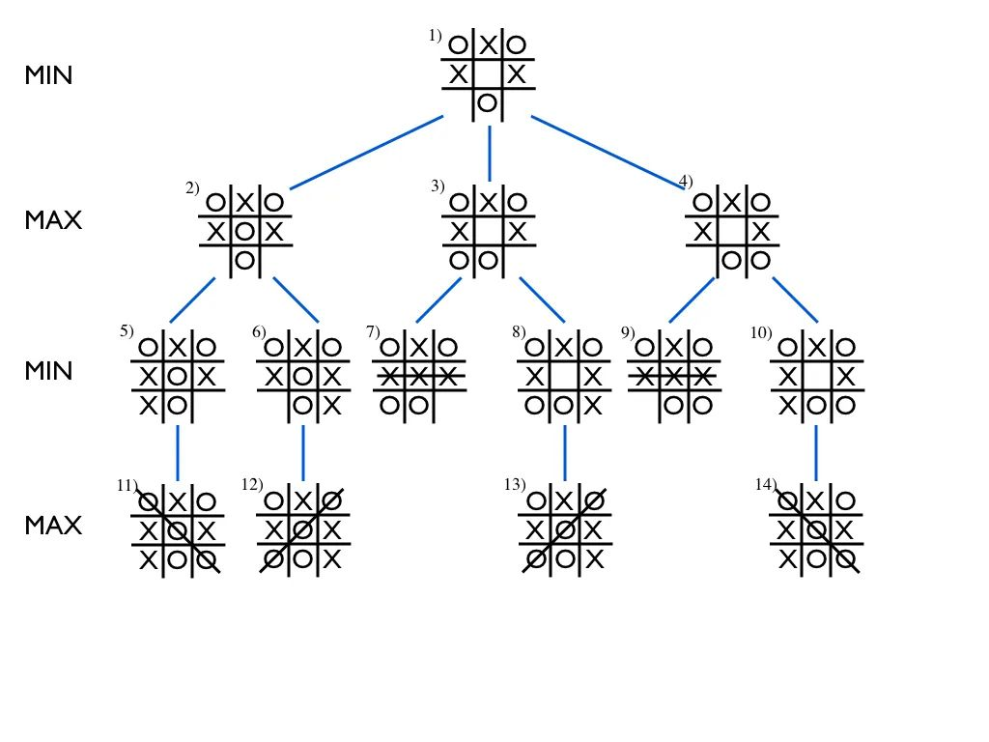
Team PathSeeker
PAGE 16
RECOMMENDATION
So, We Can Conclude That…
Is Single Agent Search enough..?

Slide 17
Team PathSeeker
PAGE 17
RECOMMENDATION
Is Single Agent Search enough..?
....
OPTIMAL
PATH SEEKER

Slide 18
Team
PathSeeker
NEW ISMAILIA NATIONAL UNIVERSITY
RECOMMENDATION
REFERENCES
OPTIMAL
PATH SEEKER
Russell, S., & Norvig, P. (2021). Artificial Intelligence: A Modern Approach (4th ed.). Pearson Education.
Halim, S. (2011). VisuAlgo – Visualising Data Structures and Algorithms. National University of Singapore.
https://visualgo.net
Dijkstra, E. W. (1959). A note on two problems in connexion with graphs.
Numerische Mathematik, 1, 269–271.
Hart, P. E., Nilsson, N. J., & Raphael, B. (1968). A formal basis for the heuristic determination of minimum cost paths. IEEE Transactions on Systems Science and Cybernetics, 4(2), 100–107.
Nilsson, N. J. (1980). Principles of Artificial Intelligence. Morgan Kaufmann.
Pearl, J. (1984). Heuristics: Intelligent Search Strategies for Computer Problem Solving. Addison-Wesley.
Is Single Agent Search enough..?
PAGE 20

Slide 19
Any Question?
Team PathSeeker
PAGE 19
REFERENCES
Russell, S., & Norvig, P. (2021). Artificial Intelligence: A Modern Approach (4th ed.). Pearson Education.
Halim, S. (2011). VisuAlgo – Visualising Data Structures and Algorithms. National University of Singapore.
https://visualgo.net
Dijkstra, E. W. (1959). A note on two problems in connexion with graphs.
Numerische Mathematik, 1, 269–271.
Hart, P. E., Nilsson, N. J., & Raphael, B. (1968). A formal basis for the heuristic determination of minimum cost paths. IEEE Transactions on Systems Science and Cybernetics, 4(2), 100–107.
Nilsson, N. J. (1980). Principles of Artificial Intelligence. Morgan Kaufmann.
Pearl, J. (1984). Heuristics: Intelligent Search Strategies for Computer Problem Solving. Addison-Wesley.

Slide 20




Presented by
Amr Maarouf
Team
PathSeeker
NEW ISMAILIA NATIONAL UNIVERSITY
Any Question?
Aya Mohamed
Mohamed Elaraby
Thank You!
Jana Elhadidy
Laila Khaled
PAGE 21
Any Question?

Slide 21
Team
PathSeeker
NEW ISMAILIA NATIONAL UNIVERSITY
Power Point
Mustafa Shehata
Thank You!
Team Leader
Amr Maarouf
AIEP
Second Year
PAGE 22

